Slide 1


Excellence in Business Communication - Chapter 5 ENL 320

Slide 2


Slide 3
Excellence in Business Communication
Chapter 5
Writing Business Messages

Slide 4
Learning Objectives (1 of 3)
Identify the four aspects of being sensitive to audience needs when writing business messages.
Explain how establishing your credibility and projecting your company’s image are vital aspects of building strong relationships with your audience.

Slide 6
Learning Objectives (2 of 3)
Explain how to achieve a tone that is conversational but businesslike, explain the value of using plain language, and define active and passive voice.
Describe how to select words that are both correct and effective.

Slide 7
Learning Objectives (3 of 3)
Define the four types of sentences, and explain how sentence style affects emphasis within a message.
Define the three key elements of a paragraph, and list five ways to develop unified, coherent paragraphs.
List five techniques for writing effective messages for mobile readers.

Slide 8
Adapting to Your Audience: Being Sensitive to Your Audience’s Needs
(LO 1) Identify the four aspects of being sensitive to audience needs when writing business messages.
Notes:
Audiences tend to greet incoming messages with a simple question: “What’s in this for me?” If your target readers or listeners don’t think a message applies to them, or they don’t think you are being sensitive to their needs, they won’t pay attention. You can improve your audience sensitivity by adopting the “you” attitude, maintaining good standards of etiquette, emphasizing the positive, and using bias-free language.

Slide 9
Being sensitive to audience needs
1. use the you attitude
2. maintain standards of etiquette
Emphasize the positive
Use bias-free language

Slide 10
Adopting a “You” Attitude (1 of 2)
Audience-Centered Approach
Hopes
Wishes
Interests
Preferences
Notes:
In the “audience-centered approach,” you try to see a subject through your audience’s eyes. You can project this approach in your messages by adopting a “you” attitude––that is, speaking and writing in terms of the audience’s wishes, interests, hopes, and preferences.

Slide 11
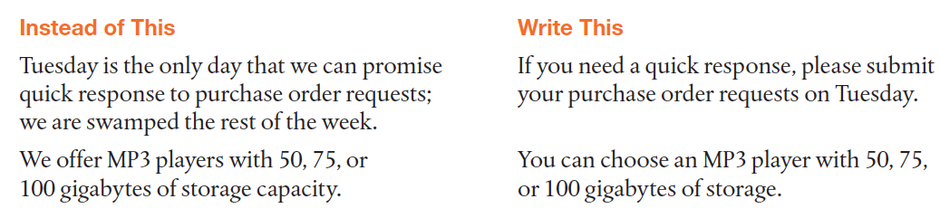
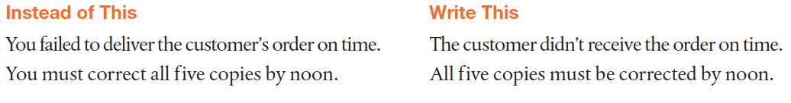
Adopting a “You” Attitude (2 of 2)
Notes:
On the simplest level, you can adopt the “you” attitude by replacing terms such as I, me, mine, we, us, and ours with you and yours.
However, the “you” attitude is more than simply using particular pronouns. It’s a matter of demonstrating genuine interest in your readers and concern for their needs. You can use you 25 times in a single page and still offend your audience or ignore readers’ true concerns. If you’re writing to a retailer, try to think like a retailer; if you’re dealing with a production supervisor, put yourself in that position; if you’re writing to a dissatisfied customer, imagine how you would feel at the other end of the transaction. Be aware that on some occasions, it’s better to avoid using you, particularly if doing so will sound overly authoritative or accusing:

Slide 12
Rewrite for better you attitude
I think that the knowledge and effort you put in this essay is minimal.

Slide 13
This essay can benefit from revision of the organization and editing for grammar and spelling mistakes.

Slide 14
Maintaining Standards of Etiquette (1 of 2)
Respect
Diplomacy
Tactfulness
Notes:
Good etiquette is not only a way to show respect for your audience; it also helps foster a more successful environment for communication by minimizing negative emotional reactions.
Some situations require more diplomacy than others. If you know your audience well, a less formal approach might be more appropriate. However, when you are communicating with people who outrank you or with people outside your organization, an added measure of courtesy is usually called for.
Written communication and most forms of electronic media generally require more tact than oral communication. When you are speaking, your words can be softened by your tone of voice or facial expression, and you can adjust your approach according to the feedback you get. If what you have written on a blog or said in a podcast offends someone, however, you may never know it.

Slide 15
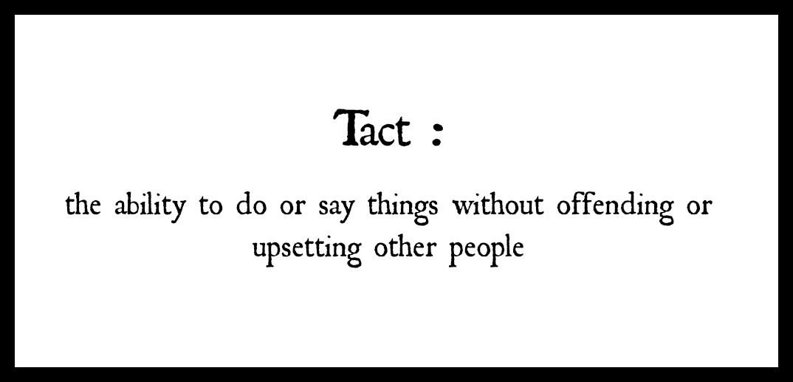

Slide 16

How does this image represent tact?

Slide 17
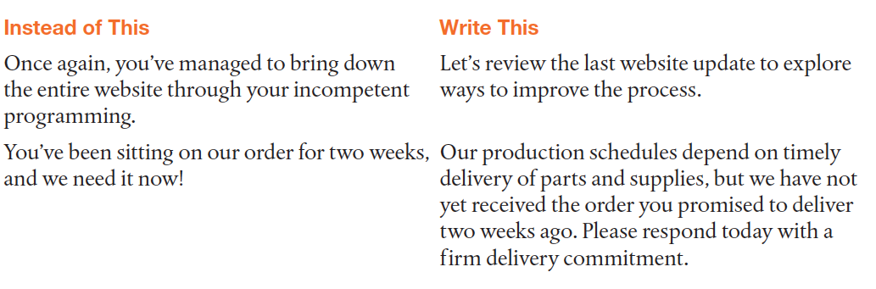
Maintaining Standards of Etiquette (2 of 2)

Slide 18
Emphasizing the Positive (1 of 2)
Avoid Negative Language:
Focus on ways to improve.
Emphasize audience benefits.
Use Euphemisms Appropriately:
Be honest but not harsh.
Don’t hide the facts.
Notes:
Sensitive communicators understand the difference between delivering negative news and being negative. Never try to hide the negative news, but look for positive points that will foster a good relationship with your audience. In addition, if you are trying to persuade your audience to perform a particular action, point out how doing so will benefit them.
In general, try to state your message without using words that might hurt or offend your audience. Substitute euphemisms (milder synonyms) for terms with unpleasant connotations. That way, you can be honest without being harsh. However, remember that you walk a fine line between softening the blow and hiding the facts when using euphemisms.

Slide 19
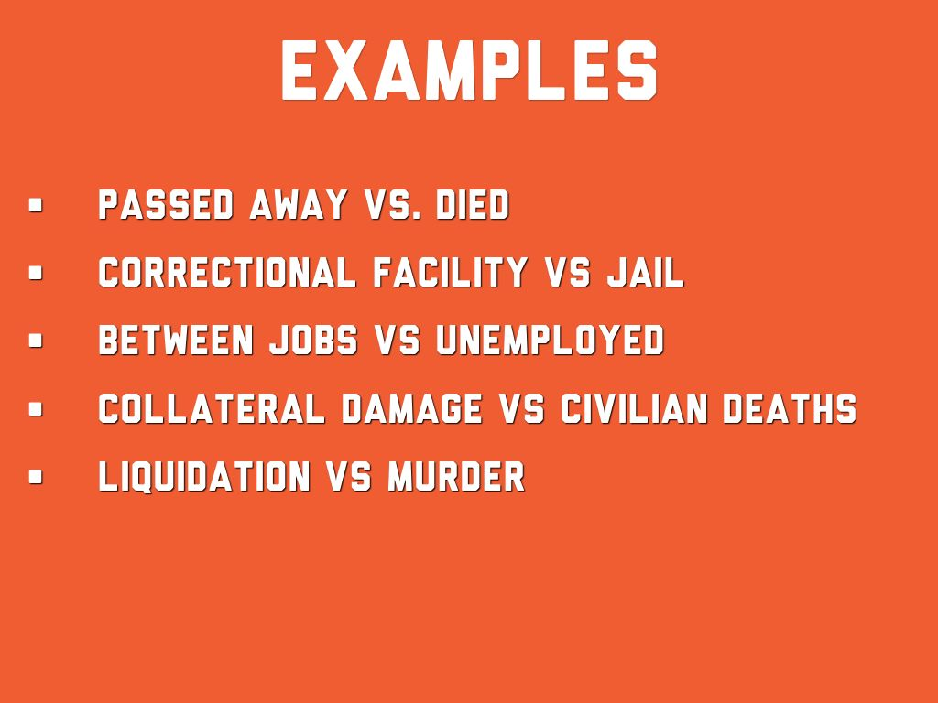
Use euphemisms to avoid sounding harsh or negative

Slide 20
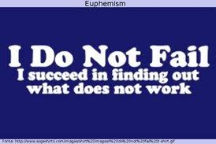
What do you think of this euphemism?

Slide 21
Which one of each pair is more positive?
A. You mentioned that B. You claimed that

Slide 22
You informed us that
You complained that

Slide 23
A. We have not received
B. We are yet to receive

Slide 24
Rewrite to make less negative
We do not exchange

Slide 25
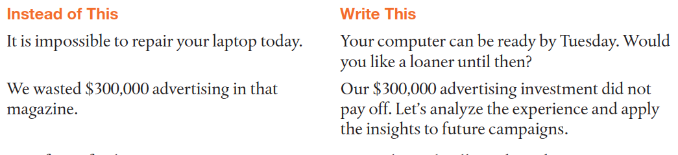
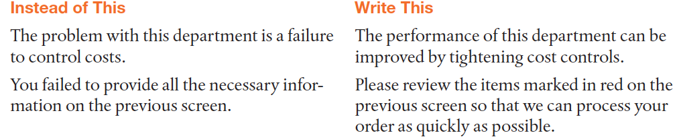
Emphasizing the Positive (2 of 2)

Slide 26
I have been given no backup.

Slide 27
Emphasizes Harsh Statement
Our records indicate that you were recently fired.

Slide 28
De-emphasizes Harsh Statement
Our records indicate that your employment status has recently changed.

Slide 29
Which sentence de-emphasizes the credit refusal?
a. We are unable to grant you credit at this time, but we welcome your cash business and encourage you to reapply in the future.
b. Although credit cannot be granted at this time, we welcome your cash business and encourage you to reapply in the future.

Slide 30
Which de-emphasizes the refusal?
. a. Although our resources are committed to other projects this year, we hope to be able to contribute to your worthy cause next year.
b. We can’t contribute to your charity this year.

Slide 31
Which one is more specific
A. Profits in beauty care products dropped 15 percent last quarter.
B. One division’s profits decreased last quarter.

Slide 32
Using Bias-Free Language (1 of 2)
Gender
Age
Avoid Bias
Race/Ethnicity
Disability
Notes:
Bias-free language avoids words or phrases that categorize or stigmatize people related to gender, race, ethnicity, age, and disability.

Slide 33
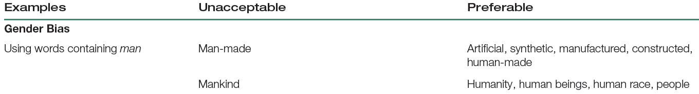
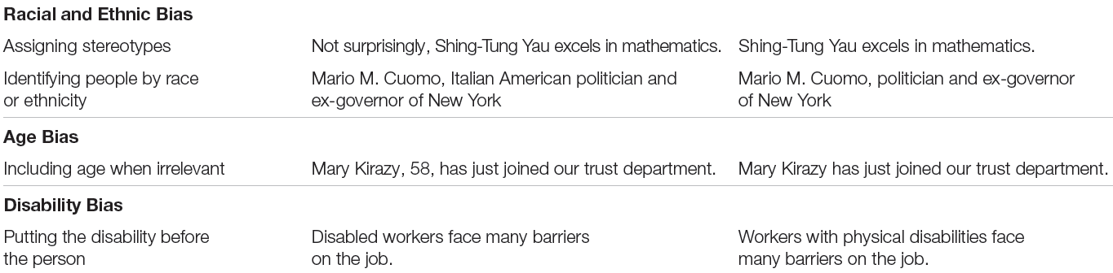
Using Bias-Free Language (2 of 2)
Notes:
Bias can take a variety of forms:
Gender bias. Avoid sexist language by using the same label for everyone, regardless of gender. For example, don’t call a woman chairperson and then call a man chairman. Reword sentences to use they or to use no pronoun at all rather than refer to all individuals as he.
Racial and ethnic bias. Avoid identifying people by race or ethnic origin unless such a label is relevant to the matter at hand—and it rarely is.
Age bias. Mention the age of a person only when it is relevant, and be careful of the context if you must use words that refer to age.
Disability bias. Avoid mentioning physical, mental, sensory, or emotional impairments in business messages, unless those conditions are directly relevant. If you must refer to someone’s disability, put the person first and the disability second.

Slide 34
For an Indian, Maggy certainly is outgoing.

Slide 35
A pilot must have the ability to stay calm under pressure, and then he must be trained to cope with any problem.

Slide 36
Adapting to Your Audience: Building Strong Relationships
(LO 2) Explain how establishing your credibility and projecting your company’s image are vital aspects of building strong relationships with your audience.
Notes:
Successful communication relies on a positive relationship between sender and receiver. Establishing your credibility and projecting your company’s image are two vital steps in building and fostering positive business relationships.

Slide 37
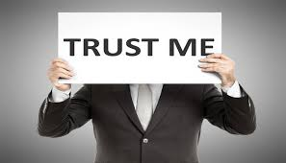
Establishing your credibility is vital in building and fostering positive business relationships.

Slide 38
Establishing Your Credibility (1 of 2)
Honesty
Objectivity
Awareness of Audience Needs
Credentials, Knowledge, and Expertise
Notes:
Your audience's response to every message you send depends heavily on their perception of your credibility—a measure of your believability based on how reliable you are and how much trust you evoke in others. Whether you're working to build credibility with a new audience, to maintain credibility with an existing audience, or to restore credibility after a mistake, consider emphasizing the following characteristics:
Honesty. Demonstrating honesty and integrity will earn you the respect of your colleagues and the trust of everyone you communicate with, even if they don't always agree with you.
Objectivity. Distance yourself from emotional situations and look at all sides of an issue. Audience members want to believe that you have their interests in mind, not just your own.
Awareness of audience needs. Let your audience know that you understand what's important to them. If you've done a thorough audience analysis, you'll know what your audience cares about in a particular situation.
Credentials, knowledge, and expertise. Every audience wants to be assured that the messages they receive come from people who know what they're talking about. To establish credibility with a new audience, put yourself in their shoes and identify the credentials that would be most important to them.

Slide 39
Establishing Your Credibility (2 of 2)
Endorsements
Performance
Sincerity
Self-Confidence
Notes:
Endorsements. If your audience doesn't know anything about you, you might be able to get assistance from someone they do know and trust.
Performance. It's easy to say you can do something, but following through can be much harder. Impressive communication skills are not enough; people need to know they can count on you to get the job done.
Confidence. Audiences also need to know that you believe in yourself and your message.
Sincerity. When you offer praise, don’t use hyperbole, such as “you are the most fantastic employee I could ever imagine.” Instead, point out specific qualities that warrant praise.
Credibility can take a long time to establish—and it can be wiped out in an instant. An occasional mistake is usually forgiven, but major lapses in honesty or integrity can destroy your reputation. On the other hand, when you do establish credibility, communication becomes much easier because you no longer have to spend time and energy convincing people that you are trustworthy.

Slide 40
Projecting Your Company’s Image
Communication Style
Communication Guidelines
Notes:
When you communicate with anyone outside your organization, you represent your company. Therefore, you play a vital role in helping the company build and maintain positive relationships with its stakeholders. As part of this responsibility, the interests and preferred communication style of your company must take precedence over your own views and style.
Many organizations have specific communication guidelines that show everything from the correct use of the company name to preferred abbreviations and other grammatical details. Specifying a desired style of communication is more difficult, however. Observe more experienced colleagues to see how they communicate, and never hesitate to ask for editorial help to make sure you’re conveying the appropriate tone.

Slide 41
Adapting to Your Audience: Controlling Your Style and Tone
(LO 3) Explain how to achieve a tone that is conversational but businesslike, explain the value of using plain language, and define the active and passive voice.
Notes:
Your communication style involves the choices you make to express yourself: the words you select, the manner in which you use those words in sentences, and the way you build paragraphs from individual sentences. Your style creates a certain tone, or overall impression, in your messages. The right tone depends on the nature of your message and your relationship with the reader.

Slide 42
Creating a Conversational Tone
Don’t Confuse Texting and Writing
Avoid Stale and Obsolete Language
Avoid Preaching and Bragging
Be Careful with Intimacy and Humor
Notes:
The tone of your business messages can range from informal to conversational to formal. Part of the challenge of communicating on the job is to analyze each situation and figure out the appropriate tone to use. You can achieve a tone that is conversational but still businesslike by using the following guidelines:
Understand the difference between texting and writing. The casual, acronym-filled language friends often use in text messaging, IMs, and social networks is not professional business writing. If you want to be taken seriously in business, you simply cannot write like that on the job.
Avoid obsolete and pompous language. Avoid using dated phrases, obscure words, stale or clichéd expressions, and overly complicated sentences.
Avoid preaching and bragging. Few things are more irritating than know-it-alls who like to preach or brag. However, if you need to remind your audience of something that should be obvious, try to work in the information casually, where it will sound like a secondary comment rather than a major revelation.
Be careful with intimacy. Business messages should avoid intimacy. However, when you have a close relationship with audience members, such as among the members of a close-knit team, a more intimate tone is sometimes appropriate and even expected.
Be careful with humor. If you don’t know your audience well or you’re not skilled at using humor in a business setting, don’t use it at all. Avoid humor in formal messages and when you’re communicating across cultural boundaries.

Slide 43
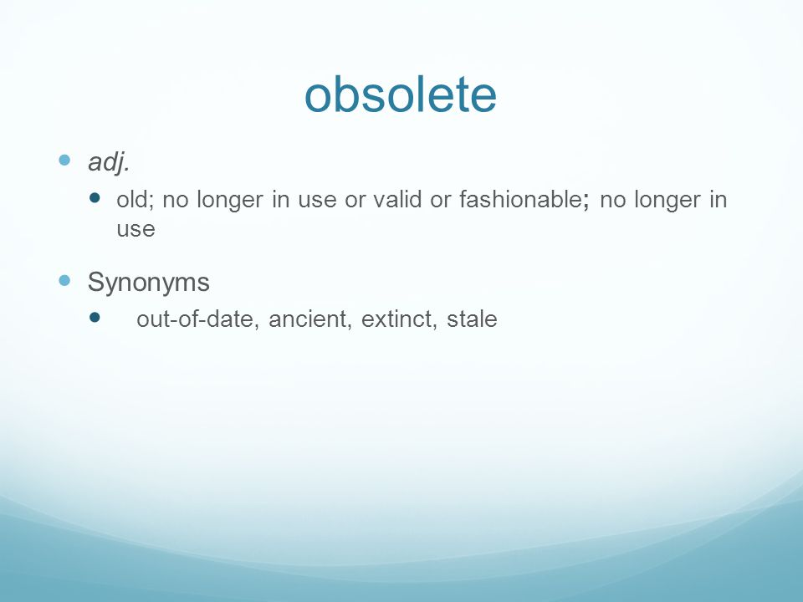
Stale and obsolete language

Slide 45
Using Plain Language
Prefer a Simple, Unadorned Style
Support the “You” Attitude
Show Respect for the Audience
Boost Productivity and Profitability
Notes:
Plain language presents information in a simple, unadorned style so that your audience can easily grasp your meaning—language that recipients “can read, understand, and act upon the first time they read it.” You can see how this definition supports using the “you” attitude and shows respect for your audience. In addition, plain language can make companies more productive and more profitable because people spend less time trying to figure out messages that are confusing or that aren’t written to meet their needs.

Slide 46
Definition of plain language
Plain language presents information in a simple, unadorned style so that your audience can easily grasp your meaning—language that recipients “can read, understand, and act upon the first time they read it.”

Slide 47
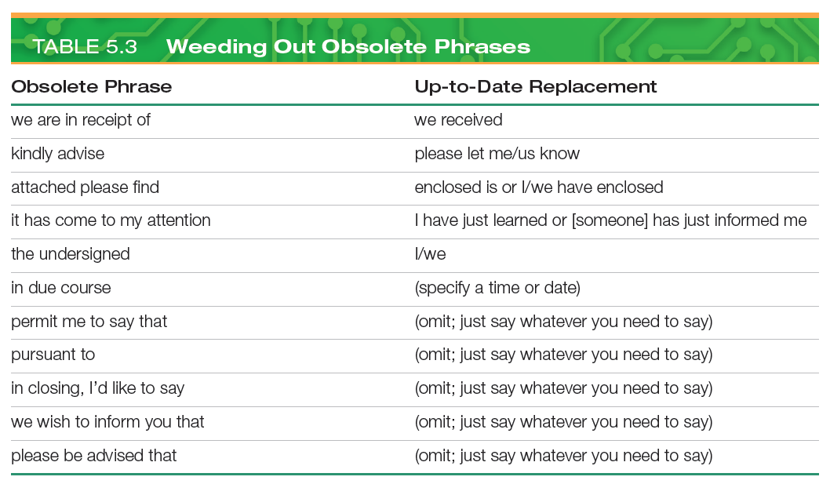
Using Plain Language

Slide 48
Selecting Active Voice or Passive Voice (1 of 2)
Dull and Indirect (Passive Voice)
Legal problems are created by this contract.
The new system was proposed by the project team.
Lively and Direct (Active Voice)
This contract creates legal problems.
The project team proposed a new system.
Notes:
Your choice of active or passive voice also affects the tone of your message. You are using active voice when the subject ("actor") comes before the verb, and the object (“acted upon”) comes after the verb: "Joe rented the car." Use the active voice to produce shorter, stronger sentences and make your writing more vigorous, concise, and generally easier to understand.
In general, avoid passive voice to make your writing lively and direct.

Slide 49
When to use active voice
Use the active voice to produce shorter, stronger sentences and make your writing more vigorous, concise, and generally easier to understand

Slide 50
Selecting Active Voice or Passive Voice (2 of 2)
Accusatory or Self-Congratulatory (Active Voice)
You lost the shipment.
I recruited seven engineers last month.
More Diplomatic (Passive Voice)
The shipment was lost.
Seven engineers were recruited last month.
Notes:
You are using passive voice when the subject follows the verb and the object precedes it: "The car was rented by Joe." As you can see, the passive voice combines the helping verb to be with a form of the verb that’s usually similar to the past tense. The passive voice is not wrong grammatically, but it is often vague and makes sentences longer.
Nevertheless, using the passive voice can demonstrate the "you" attitude in some situations:
When you want to be diplomatic about pointing out a problem or error of some kind.
When you want to point out what's being done without taking or attributing either the credit or the blame.
When you want to avoid personal pronouns in order to create an objective tone.
Passive voice is helpful when you want to be diplomatic or focus attention on problems or solutions, rather than on people.

Slide 51
When to use the passive voice
Passive voice is helpful when you want to be diplomatic or focus attention on problems or solutions, rather than on people.

Slide 52
to point out what's being done without taking or attributing either the credit or the blame.
You lost the shipment.
I recruited seven engineers last month.

Slide 53
Use the passive
When you want to avoid personal pronouns in order to create an objective tone

Slide 54
Composing Your Message: Choosing Powerful Words
(LO 4) Describe how to select words that are both correct and effective.
Notes:
After you’ve decided how to adapt to your audience, you’re ready to begin composing your message. As you write your first draft, don’t try to edit at the same time or worry about getting everything perfect. Do whatever it takes to get the ideas out of your head and onto your computer screen or a piece of paper.
If you’ve planned carefully, you’ll have time to revise and refine the material later, before showing it to anyone. You may find it helpful to review your writing at three levels: strong words, effective sentences, and coherent paragraphs.

Slide 55
Choosing Powerful Words
Effective
Grammar
Usage
Strong Words
Correct
Experience
Judgment
Notes:
Successful writers pay close attention to the correct use of words. If you make errors of grammar or usage, you lose credibility with your audience—even if your message is otherwise correct. Poor grammar implies that you’re unprofessional. Poor grammar also can imply that you don’t respect your audience enough to get things right.
In addition to using words correctly, successful writers and speakers take care to find the most effective words and phrases to use. Selecting and using words effectively is often more challenging than using words correctly because it’s a matter of judgment and experience. Therefore, careful writers seek words that communicate with power.

Slide 56
Balancing Abstract and Concrete Words
Characteristics
Tangible
Objective
Characteristics
Concepts
Qualities
Concrete Words
Abstract Words
Notes:
An abstract word expresses a concept, quality, or characteristic. Abstractions are usually broad (encompassing a category of ideas) and are often intellectual, academic, or philosophical. Love, honor, progress, tradition, and beauty are abstractions; so are important business concepts such as productivity, profits, quality, and motivation.
In contrast, a concrete word stands for something you can touch, see, or visualize. Most concrete terms are anchored in the tangible, material world. Chair, table, horse, rose, kick, kiss, red, green, and two are concrete words; they are direct, clear, and exact. Incidentally, technology generates new words and new meanings to describe things that don’t have a physical presence but are still concrete. For example, software, database, signal, and code are all concrete terms as well.

Slide 57
Finding Words that Communicate Well
Choose Strong,
Precise Words
Choose Familiar
Words
Avoid Clichés
and Buzzwords
Use Jargon
Carefully
Notes:
When you compose business messages, look for the most powerful words for each situation.
Choose strong, precise words. Choose words that express your thoughts most clearly, specifically, and dynamically. Nouns and verbs are the most concrete, so use them as much as you can. Adjectives and adverbs have obvious roles, but they often evoke subjective judgments. Verbs are especially powerful because they tell what’s happening in the sentence, so make them dynamic and specific.
Choose familiar words. You’ll communicate best with words that are familiar to your readers. However, keep in mind that words that are familiar to one reader might be unfamiliar to another.
Avoid clichés and buzzwords. Although familiar words are generally the best choice, avoid clichés—terms and phrases so common that they have lost some of their power to communicate. Buzzwords are newly coined terms often associated with technology, business, or cultural changes. Using buzzwords can signal that you’re an insider, someone in the know. However, using them too late in their “life cycle” can mark you as an outsider desperately trying to look like an insider.
Use jargon carefully. Jargon is the specialized language of a particular profession or industry; its use can help you communicate within the specific groups that understand it. When deciding whether to use jargon, let your audience’s knowledge guide you.

Slide 58
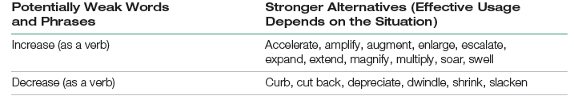


Powerful Words

Slide 59
Composing Your Message: Creating Effective Sentences
(LO 5) Define the four types of sentences, and explain how sentence style affects emphasis within a message.
Notes:
Arranging carefully chosen words in effective sentences is the next step in creating successful messages. Start by selecting the best type of sentence to communicate each point you want to make.

Slide 60
Choosing from Four Types of Sentences (1 of 2)
Simple
One main clause
Objects and phrases
Compound
Two main clauses
Joined by conjunction
Notes:
Sentences come in four basic varieties: simple, compound, complex, and compound-complex.
A simple sentence has one main clause (a single subject and a single predicate), although it may be expanded by nouns and pronouns serving as objects of the action and by modifying phrases.
In a compound sentence, two main clauses express two or more independent but related thoughts of equal importance. These clauses are usually joined by a coordinating conjunction. In effect, a compound sentence is a merger of two or more simple sentences (independent clauses) that are related.

Slide 61
Choosing from Four Types of Sentences (2 of 2)
Complex
One main clause
A dependent clause
Compound
Complex
Two main clauses
A dependent clause
Notes:
A complex sentence expresses one main thought (the independent clause) and one or more subordinate thoughts (dependent clauses) related to it, often separated by a comma.
A compound-complex sentence has two main clauses, at least one of which contains a subordinate clause.

Slide 62
Using Sentence Style to Emphasize Key Thoughts
Wording Key Ideas
•Using Extra Words
•Allocating Extra Space
Placing Key Ideas
•As Sentence Subjects
•In Dependent Clauses
Notes:
In every message, some ideas are more important than others. You can emphasize key ideas through your sentence style. One obvious technique is to give important points the most space, using extra words to describe it.
You can also call attention to a thought by making it the subject of a sentence. As a subject, it will tell who or what is doing the action or is in a state of being.
Another way to emphasize an idea is to place it either at the beginning or at the end of a sentence. To emphasize an idea in a dependent clause, put that clause either at the beginning or the end of the sentence. To downplay an idea, position the dependent clause within the sentence.
Using techniques such as those outlined above will give you a great deal of control over the way your audience interprets what you have to say.

Slide 63
Composing Your Message: Crafting Coherent Paragraphs
(LO 6) Define the three key elements of a paragraph, and list five ways to develop unified, coherent paragraphs.
Notes:
Paragraphs organize sentences related to the same general topic. Readers expect every paragraph to be unified—focusing on a single topic—and coherent—presenting ideas in a logically connected way. By carefully arranging the elements of each paragraph, you help your readers grasp the main idea of your document and understand how the specific pieces of support material back up that idea.

Slide 64
Creating the Elements of a Paragraph
Topic Sentence
Support Sentences
•Introduction
•Summary
Transitions
•Explanation
•Clarification
•Justification
•Connecting
•Previewing
•Smoothing
Notes:
An effective paragraph deals with a single topic, and the topic sentence introduces that topic. This sentence, usually the first one in the paragraph, gives readers a summary of the general idea that will be covered in the rest of the paragraph.
The topic sentence needs to be explained, justified, or extended with one or more support sentences, which supply examples, evidence, and clarification. In order to promote unity, each sentence must be clearly related to the general idea being developed. A well-developed paragraph will contain enough information to make the topic sentence convincing and interesting, but it will not contain unneeded or unrelated sentences.
Transitions connect ideas by showing how one thought is related to another. They also help alert the reader to what lies ahead so that shifts and changes don’t cause confusion. In addition to helping readers understand the connections you’re trying to make, transitions give your writing a smooth, even flow.

Slide 65
Developing Paragraphs
•Illustration Pattern
•Classification Pattern
Common Approaches
•Cause and Effect Pattern
•Problem and Solution Pattern
•Comparison or Contrast Pattern
Notes:
There are a variety of options for developing paragraphs, each of which will convey a specific idea. Five of the most common approaches are as follows:
Illustration involves giving examples that demonstrate the general idea.
Classification shows how a general idea is broken into specific categories.
Cause and effect focuses on the reasons for something.
A problem and solution paragraph presents a problem and then discusses a solution.
Comparison or contrast paragraphs use similarities and differences to develop the topic.

Slide 66
Writing for Mobile Devices
(LO 7) List five techniques for writing effective messages for mobile readers.
Notes:
One obvious adaptation to make for audiences using mobile devices is to modify the design and layout of your messages to fit smaller screen sizes and different user interface features. However, modifying your approach to writing is also an important step.

Slide 67
Making Mobile Messages More Effective
Use a linear organization.
Prioritize information.
Write short, focused messages.
Use shorter subject lines and headings.
Compose shorter paragraphs.
Notes:
Reading is more difficult on small screens; consequently; a user’s ability to comprehend what they read on mobile devices is lower than it is on larger screens. Use these five techniques to make your mobile messages more effective:
Use a linear organization. With small mobile device screens, a complicated organization requires readers to zoom in and out and pan around to see all these elements at readable text sizes. To simplify reading, organize with a linear flow from the top to the bottom of the message or article.
Prioritize information. Use the inverted pyramid style favored by journalists, in which you reveal the most important information briefly at first and then provide successive layers of detail that readers can consume if they want.
Write shorter and more-focused messages and documents. Mobile users often lack the patience or opportunity to read lengthy messages or documents, so keep it short. You also could write two documents, a summary for mobile use and a longer document that readers can access with their PCs if they want more details.
Use shorter subject lines and headings. As a rule, keep subject lines and headings to around 25 characters. Make every word count. Start with the key words so readers can instantly see what the subject line or heading is about.
Use shorter paragraphs. Keep paragraphs as short as possible so readers don’t have to swipe through screen after screen before getting to paragraph breaks.

Slide 68
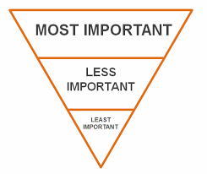
Use the inverted pyramid method by starting with the most important piece of info

Slide 69

Any Questions?

